Slide 1

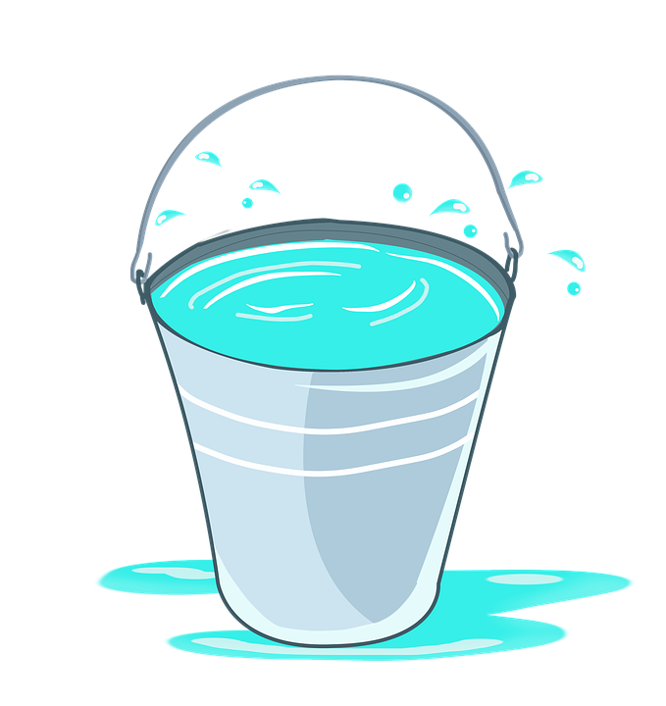
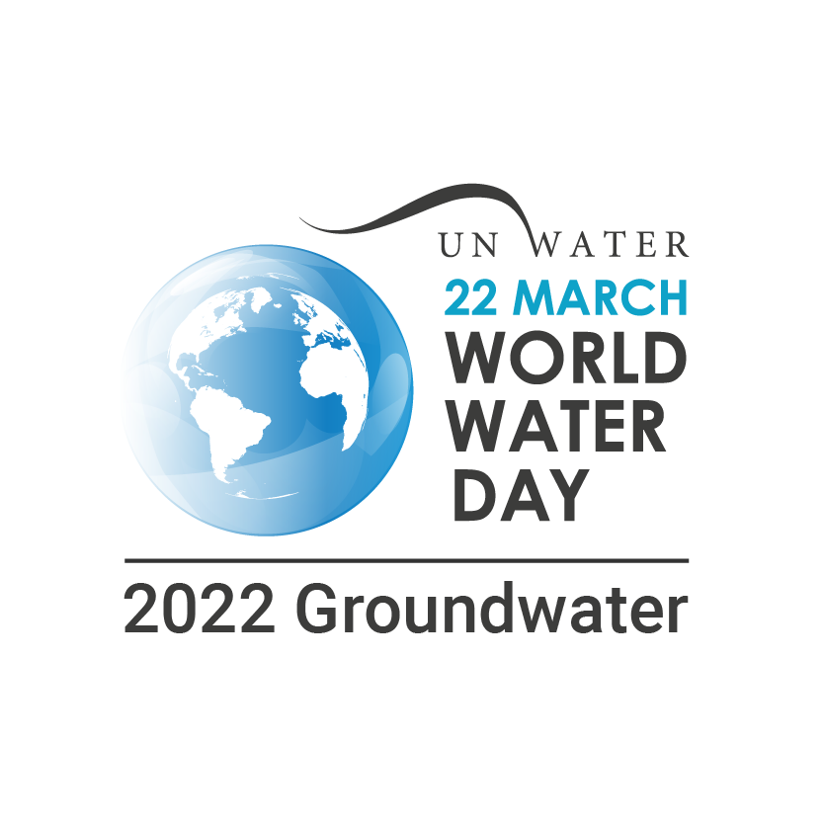
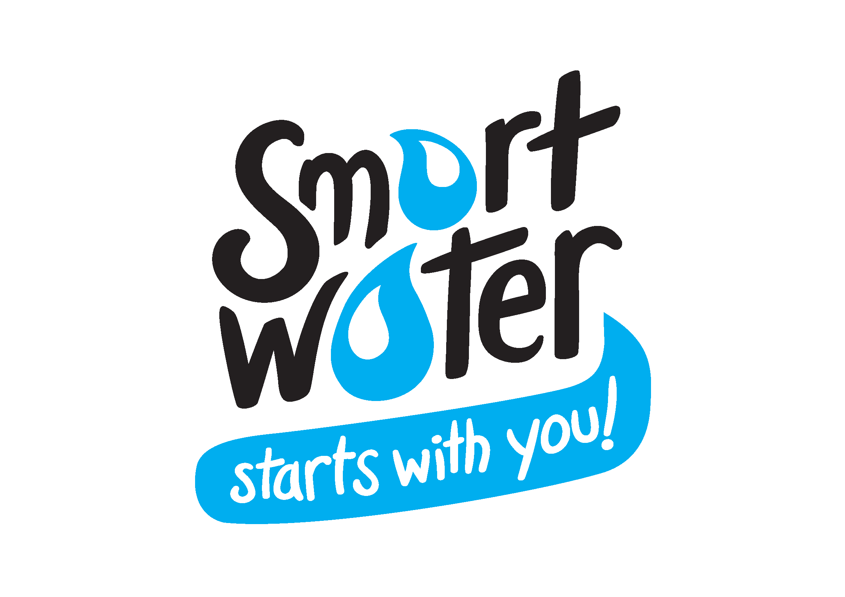

A Drop in the Bucket
Notes:
Note to teacher:
Provide the children with your Smart Water kit along with a phone or camera to video their demonstration and enter the competition:
A 9.6l Smart Water Bucket
A Smart Water Cup
A teaspoon
Salt
How much fresh water is there? Let’s find out……

Slide 2
Water Water Everywhere ?
How much water is there in the world?
Where do we find this water?
How much fresh water is there?
Notes:
Teacher Prompts
Start by finding out what students already know about global water supplies.
Answers
Reflect on how much water students think is in our world!
1,386 million cubic kilometres (km³). A cubic kilometre of water equals about 1 trillion litres.
So trillions and trillions of litres – A LOT!
Explore this with the next slide
What sources of water are there / where do we find water:
Oceans
Seas
Rivers
Lakes
Ice caps & Glaciers
Groundwater
Atmosphere
How much fresh water is there? Let’s find out……

Slide 3
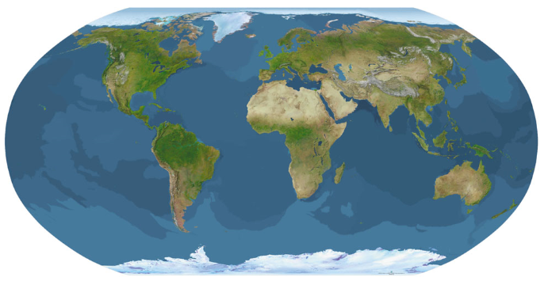
Our Earth
Water covers 70% of the earth
Notes:
Teacher Prompts
What’s does this map show?
What is all this blue stuff? (first arrow)
What is this white stuff? Is that water? (second arrow)
Do you know the name of this bottom icy bit? Antarctic Ice cap
Water covers 70% of the earth (third click)

Slide 4

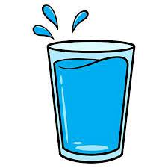
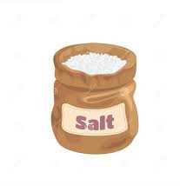

The Demonstration Part 1
What does this represent?
What does this represent?
What does this represent?
Fill up the bucket with water
Take out 1 cup of water
Add salt to the bucket
Notes:
Teacher Prompts:
Step 1:
Fill your bucket with water.
NOW IMAGINE all that water is in this bucket (HOLD UP BUCKET). This bucket represents all of the water in the world.
Step 2:
Get a student to TAKE OUT ONE MUG FULL OF WATER.
Stand aside.
Step 3:
Get a student to add the salt to the bucket.
WHAT does this water in our bucket represent now?
Answer: Salt water - Oceans & Seas - 97 % of all earth’s water is seawater.
CAN we DRINK IT? Is it ok for me to have a drink?
Can this water sustain any life? Can I water my garden with it? No
Some countries have desalinisation plants to remove the salt but this is hugely expensive and environmentally damaging.

Slide 5
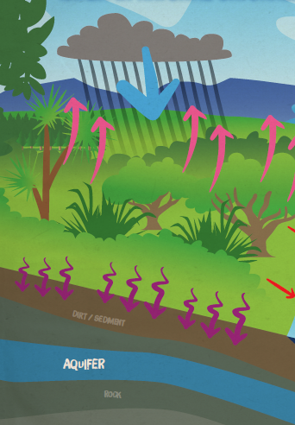
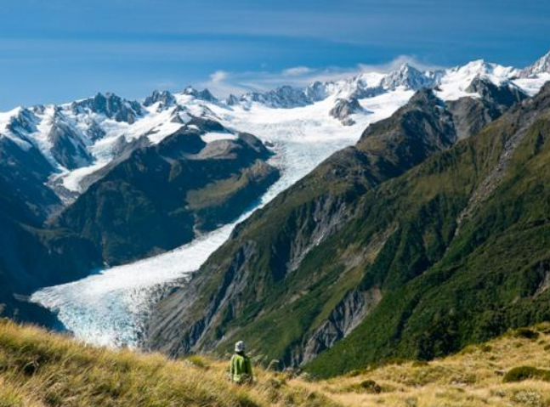
Fresh Water
Where does it come from?
69% ice caps and glaciers
30% groundwater
Notes:
Teacher Prompts
Now let’s look closer at what is in this cup.
What do you think our water in the cup represents?
This represents ALL the Fresh Water in the world. Just 3% of Water in the world is Fresh Water.
You have the one cup of fresh water…. Students have surmised what types of water it represents:
Where do we find fresh water?
Lakes
Rivers
Streams
Ice caps & Glaciers
Groundwater
Atmosphere
Most of this cup is in the white bits at the top and bottom of the earth, the Arctic and Antarctica.
In massive bits of ice called ice caps.
Point to picture of glacier – a GLACIER is a frozen river.
So most fresh water (69%) is in the Ice caps and glaciers!
Point out roughly where 69% would be or mark it on your cup.
Can we use this water to fill our drink bottles??? NO its TOO far away & it’s frozen.
NOW most of the rest of the cup is water that is deep deep down, too far for us to reach. Groundwater.
Groundwater makes up for 30 % of the world’s fresh water.
Point out roughly where 30% would be, or mark it on your cup.
Note that that is nearly our entire cup!
We’ll take a closer look at groundwater in our next lesson.
So what about our Surface water – Lakes, Rivers and streams?

Slide 6
The Demonstration Part 2
What does this represent?
Take out 1 teaspoon of water
Notes:
Teacher Prompts:
Step 4:
Student to take out one teaspoon of water from the cup.
So this tiny spoonful out of the whole bucket represents all of the water that is surface water!
Lakes, rivers, streams.
Of that 3% Fresh Water only 1% is in surface water.
One teaspoon, this little spoon is all the fresh water that is easy and close for us to treat to make safe and healthy for you to drink and use.
Did you think there was waaay more fresh water to drink?
Do you care about water more now?

Slide 7
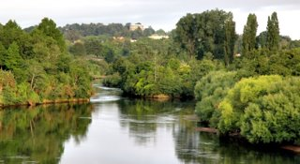
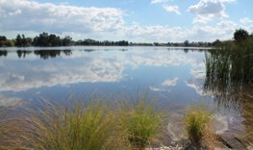
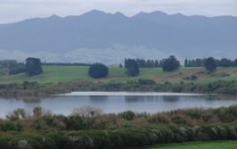
1% of fresh water is easy to get to (surface water)
Notes:
Teacher Prompts:​
​
So 1% - this tiny teaspoon out of our whole bucket = all the fresh surface water in the world!
What kind of water can you see here?​
​
What rivers lakes, streams can you name?​
​
Does anyone know where we get our drinking water from for …………..? ​
See next slide​
​

Slide 8
Where does our fresh water come from in the Waikato region?

Slide 9
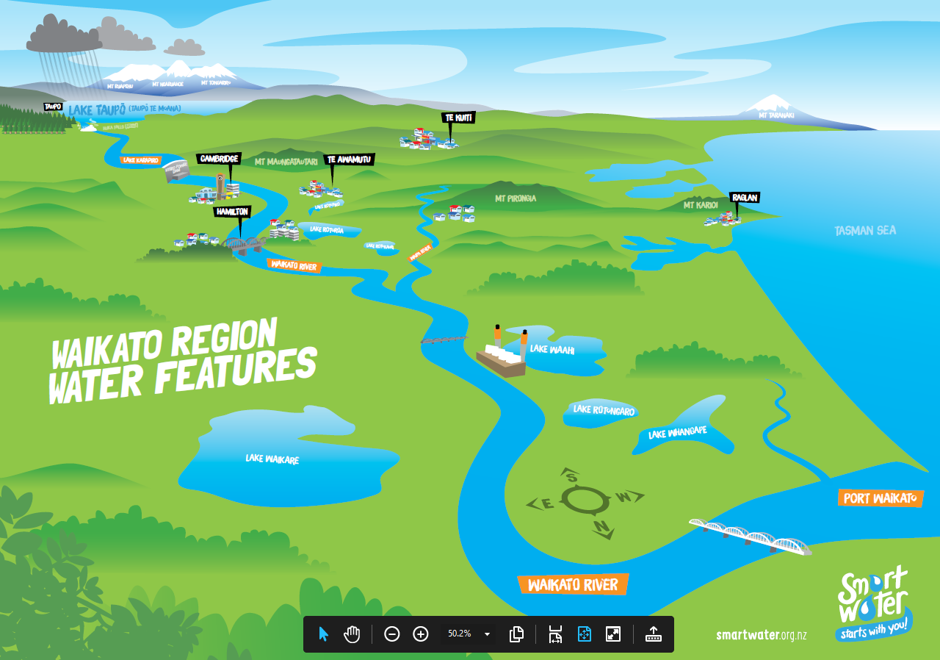
Notes:
Teacher Prompts:​
​
Hamilton’s Water sources:​
Waikato River ​
Waipas Sources:​
Waikato River - Lake Karapiro & Cambridge​
Managauika Stream – on Mt Pirongia​
Groundwater Bores – Kihikihi & Te Awamutu​
Waitomo’s Water sources:​
Mangaokewa Stream (through town)​
Surface and Underground stream - Pio Pio ​
Spring - Mokau ​
Groundwater Bore - Benneydale​
​

Slide 10
Summary
Notes:
Teacher Prompt
So if all the water in the world which covers 70% of the earth’s surface fits into the bucket….
but only 1 cup of that is fresh water.
Of that 1 cup only 1 teaspoon is easy to access and drinkable water, this is less than 1%.
How precious is our water?

Slide 11
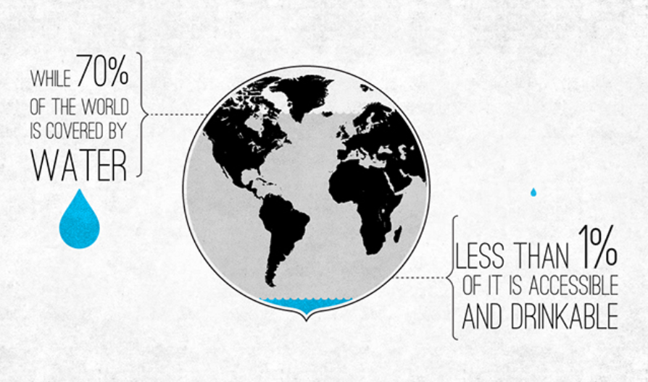

Slide 12
Thanks – we hope you enjoyed your Drop in the Bucket water demonstration.
To continue your journey and learn more about freshwater resources on earth visit us at Smart Water or check out our new Smart Water Schools Education Resources.
Here you can find curriculum resources with lots of links and activities to support your learning.

Slide 13
Our Smart Water website has loads of information on all things Fresh Water.
Check us out here
How Do we get?
Where does it come from?
How do we treat it?
Water Savings tips.
School Visits.
Educational resource – new one coming soon!
Early childhood water play.
How to guides.
Water use quizzes.

