Slide 1



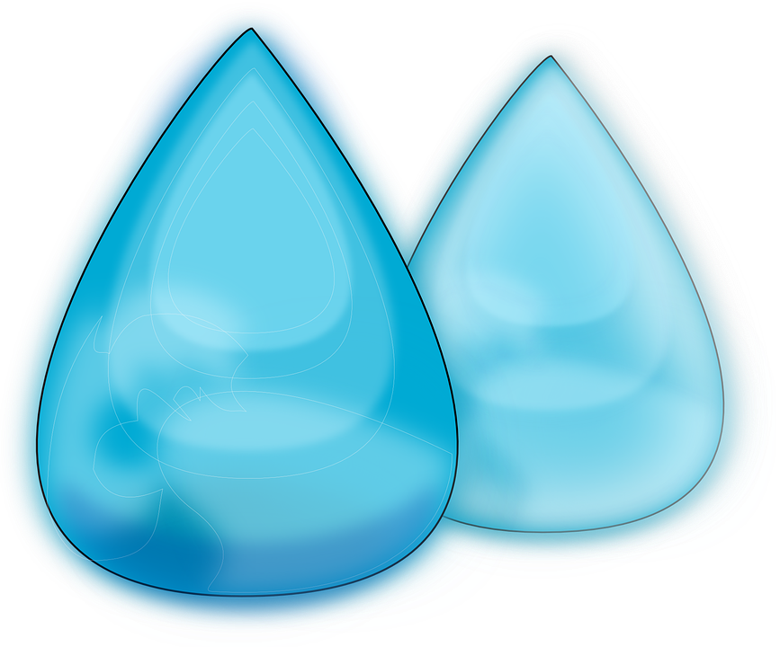

Smart Water
Water is a taonga
Notes:
Image
Water droplet, https://pixabay.com/vectors/water-drops-rain-blue-clean-clear-155735/

Slide 2
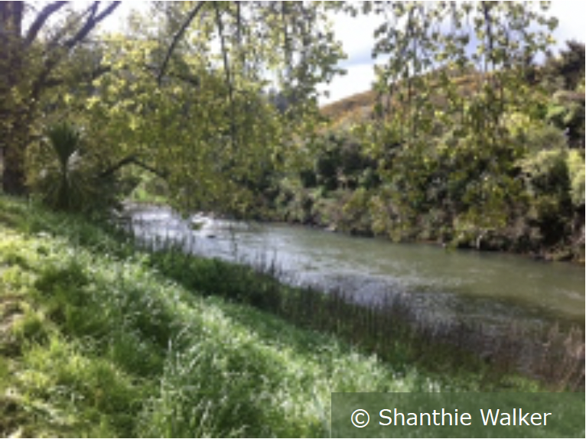
About this slideshow
This slideshow is part of a larger inquiry unit about freshwater by Smart Water and the Science Learning Hub.
Water is a taonga – slideshow is used with the activity Getting to know water.
Smart Water – a context for learning provides pedagogical information and links to all of the Smart Water resources on the Science Learning Hub.

Slide 3
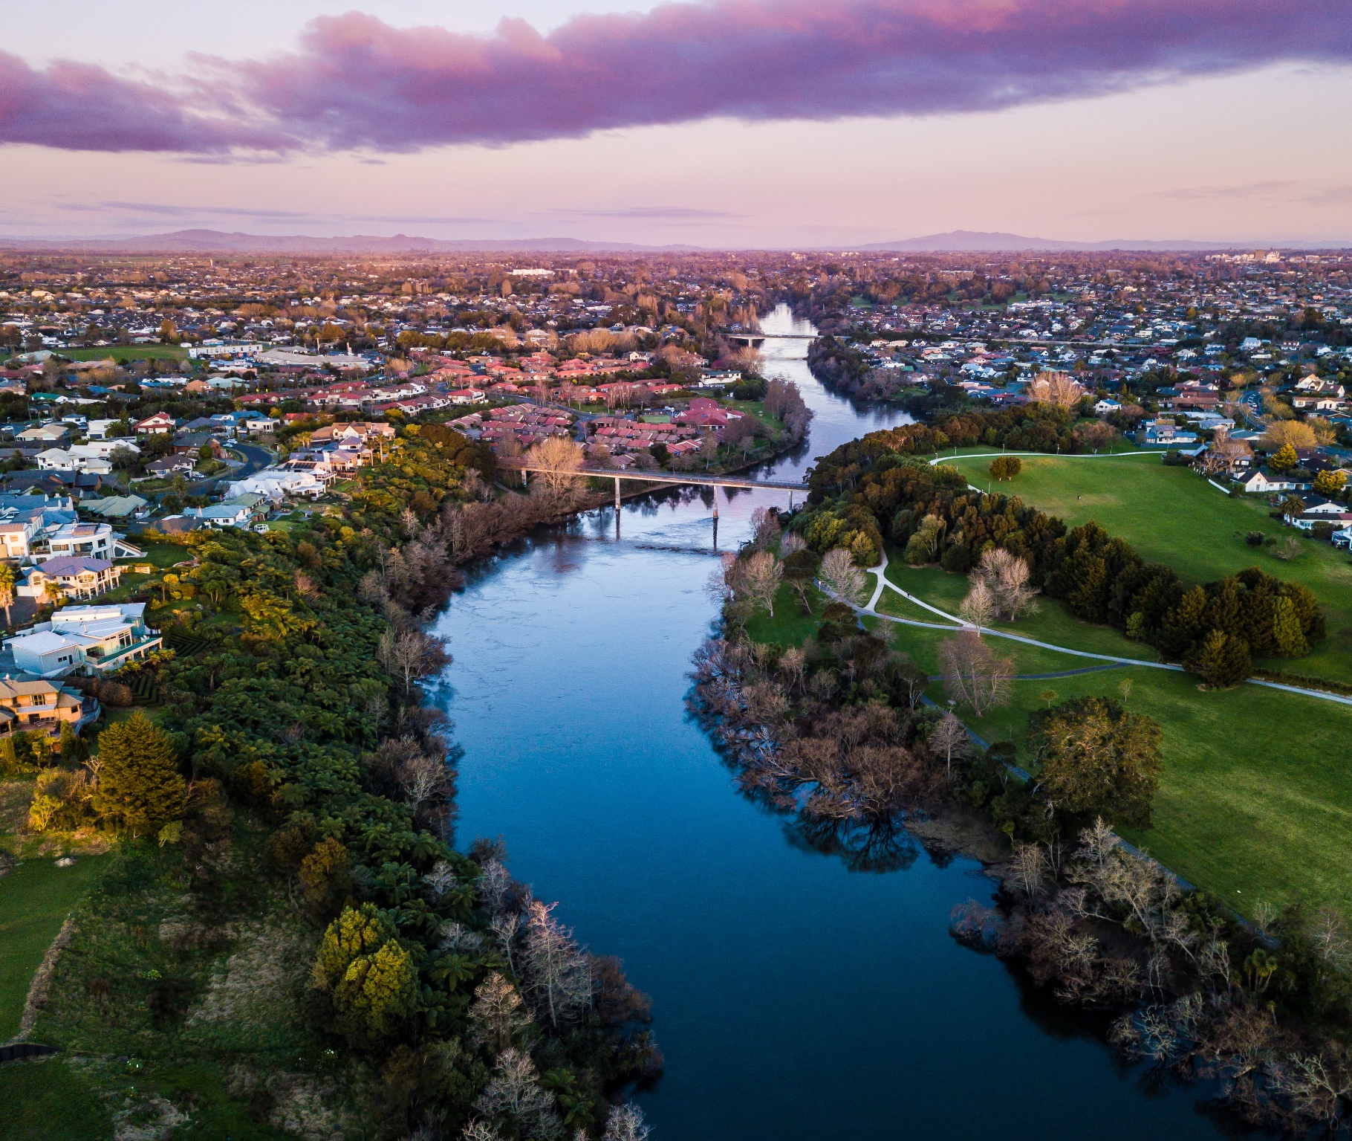
Welcome to Smart Water.
Let’s learn more about water and what we can do to look after it.
Notes:
Image: Waikato Co-op

Slide 4
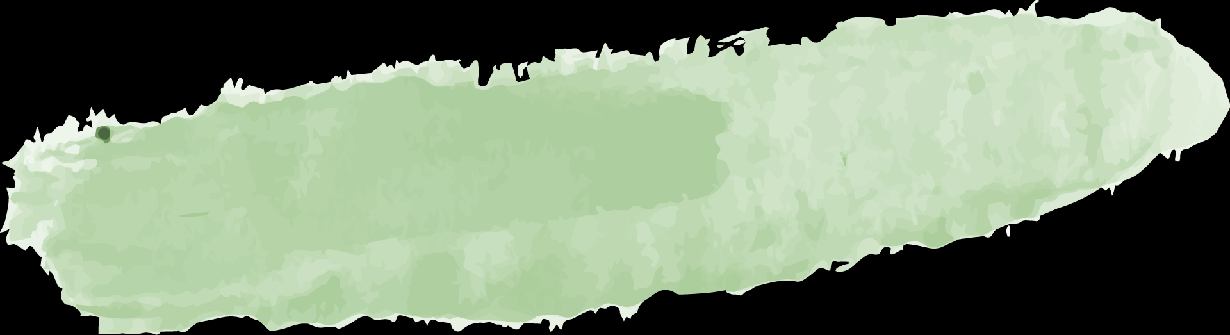
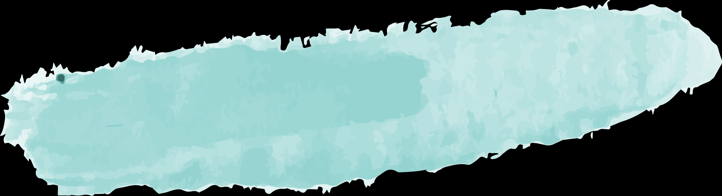
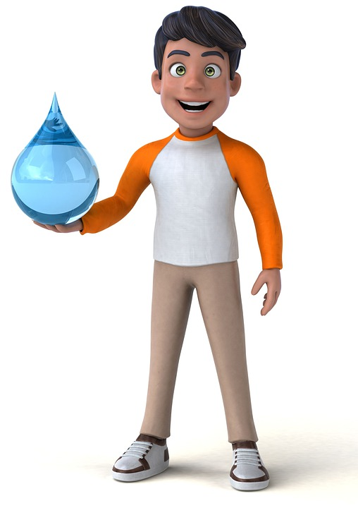
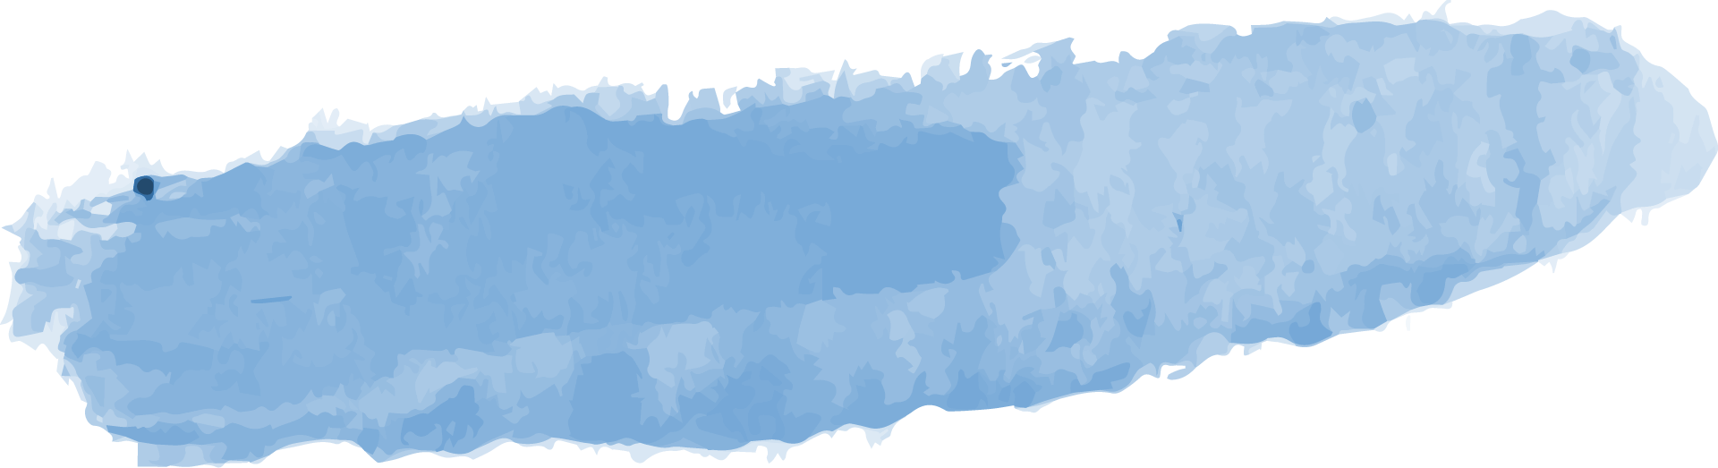
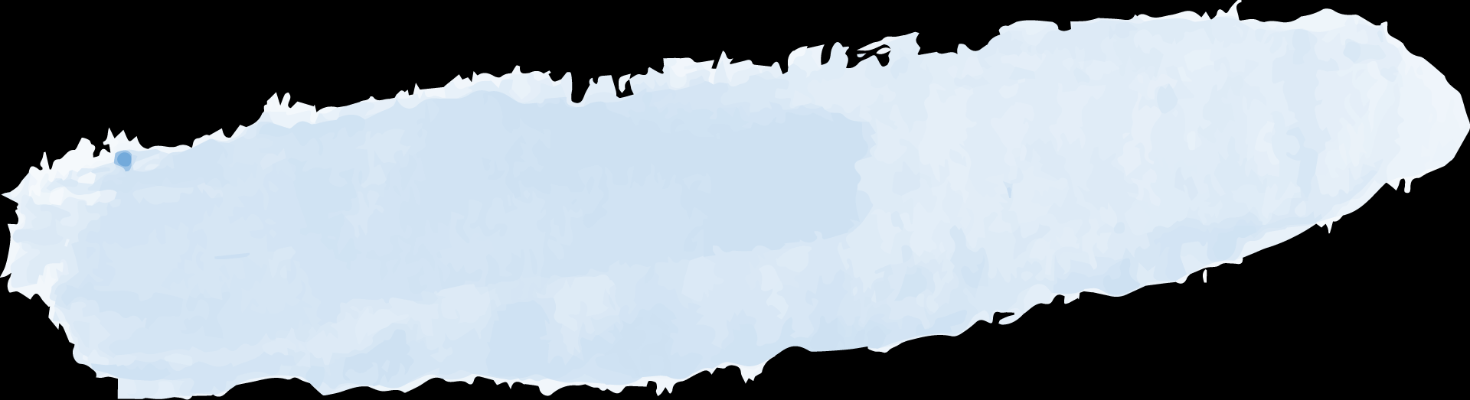
Slideshow learning intentions
1
3
2
4
We are learning to:
Recognise that water is an important taonga (treasure)
Start a learning inquiry with an overview of the Smart Water resources
Reflect on prior knowledge and experiences of water
Demonstrate the availability of
freshwater
Notes:
Image
Teen holding water, https://pixabay.com/illustrations/indian-teenager-water-adolescent-4724779/

Slide 5
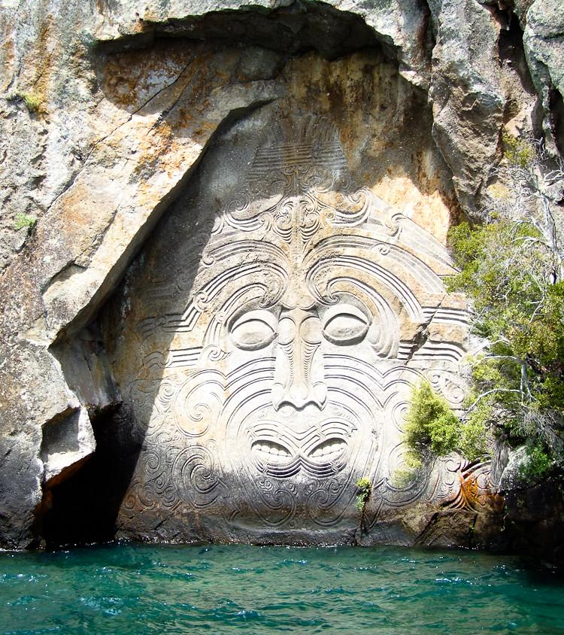
Water is a taonga
What does a taonga mean to you?
How do you feel about water?
Notes:
Discussion points:
Ask a few students to share their thoughts about water.
Discuss their understandings of what a taonga is. (A taonga is a treasure of immense value.)
Image: Larry Koester, https://www.flickr.com/photos/larrywkoester/31255360377, CC 2.0

Slide 6
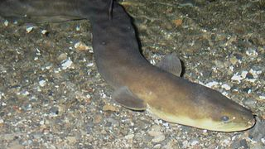
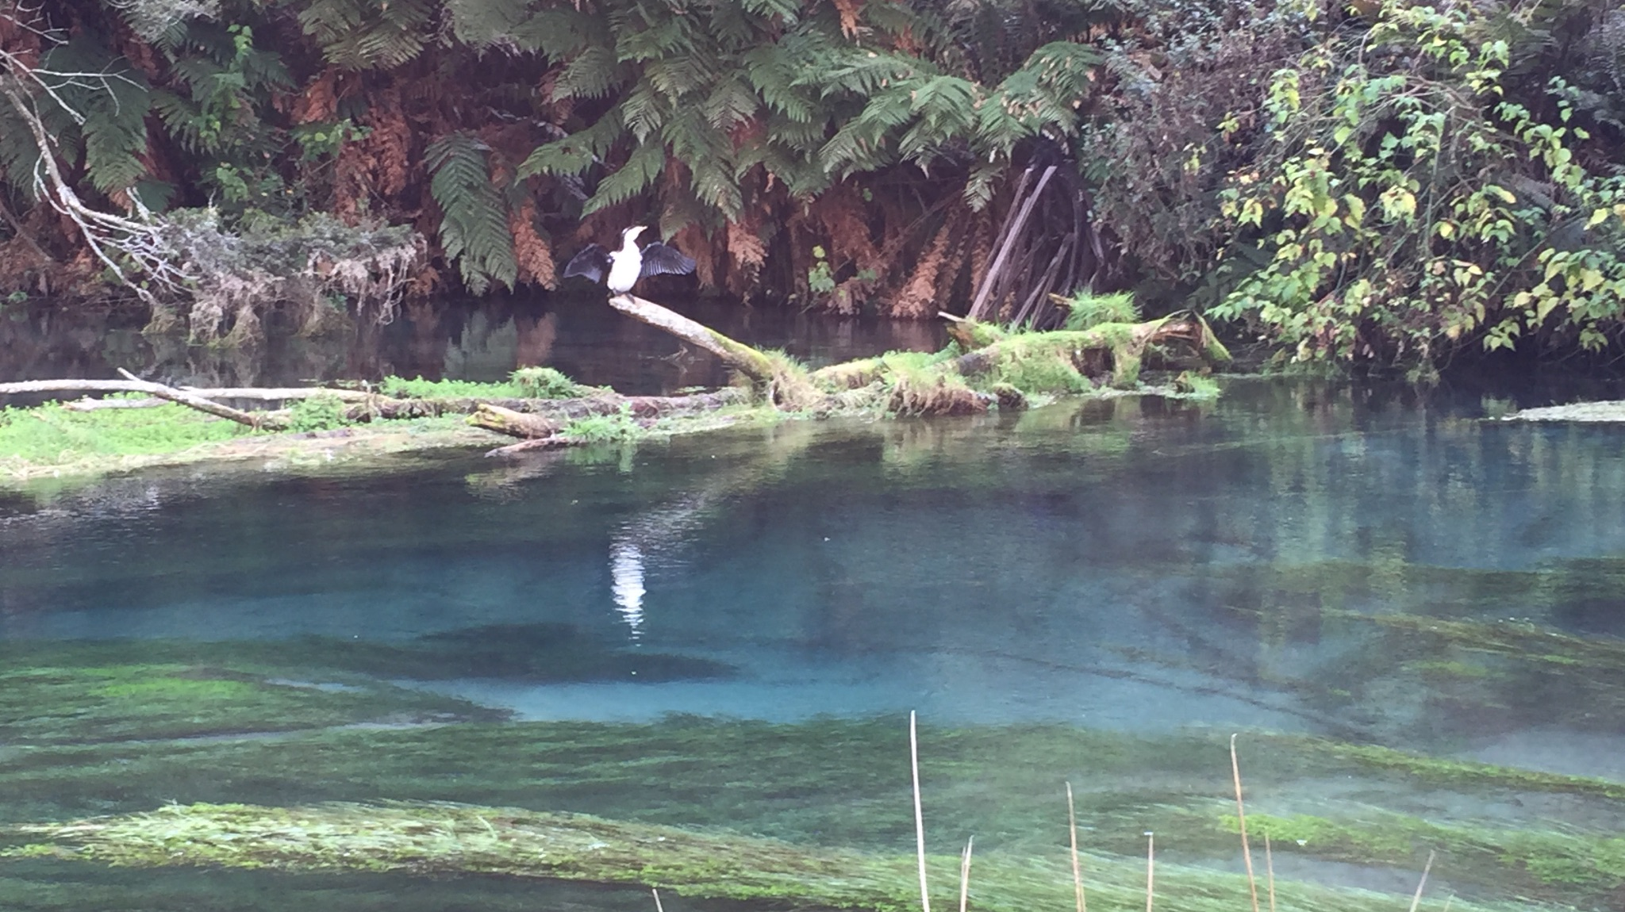
Water is amazing!
Why do we need water?
Notes:
Discussion points:
What lives in freshwater? (Eels, fish, macroinvertebrates.)
How does water support life? (It is necessary for all living things: to drink, wash, clean and bathe.)
Images
Left: Public domain
Right: Sirri Smith

Slide 7
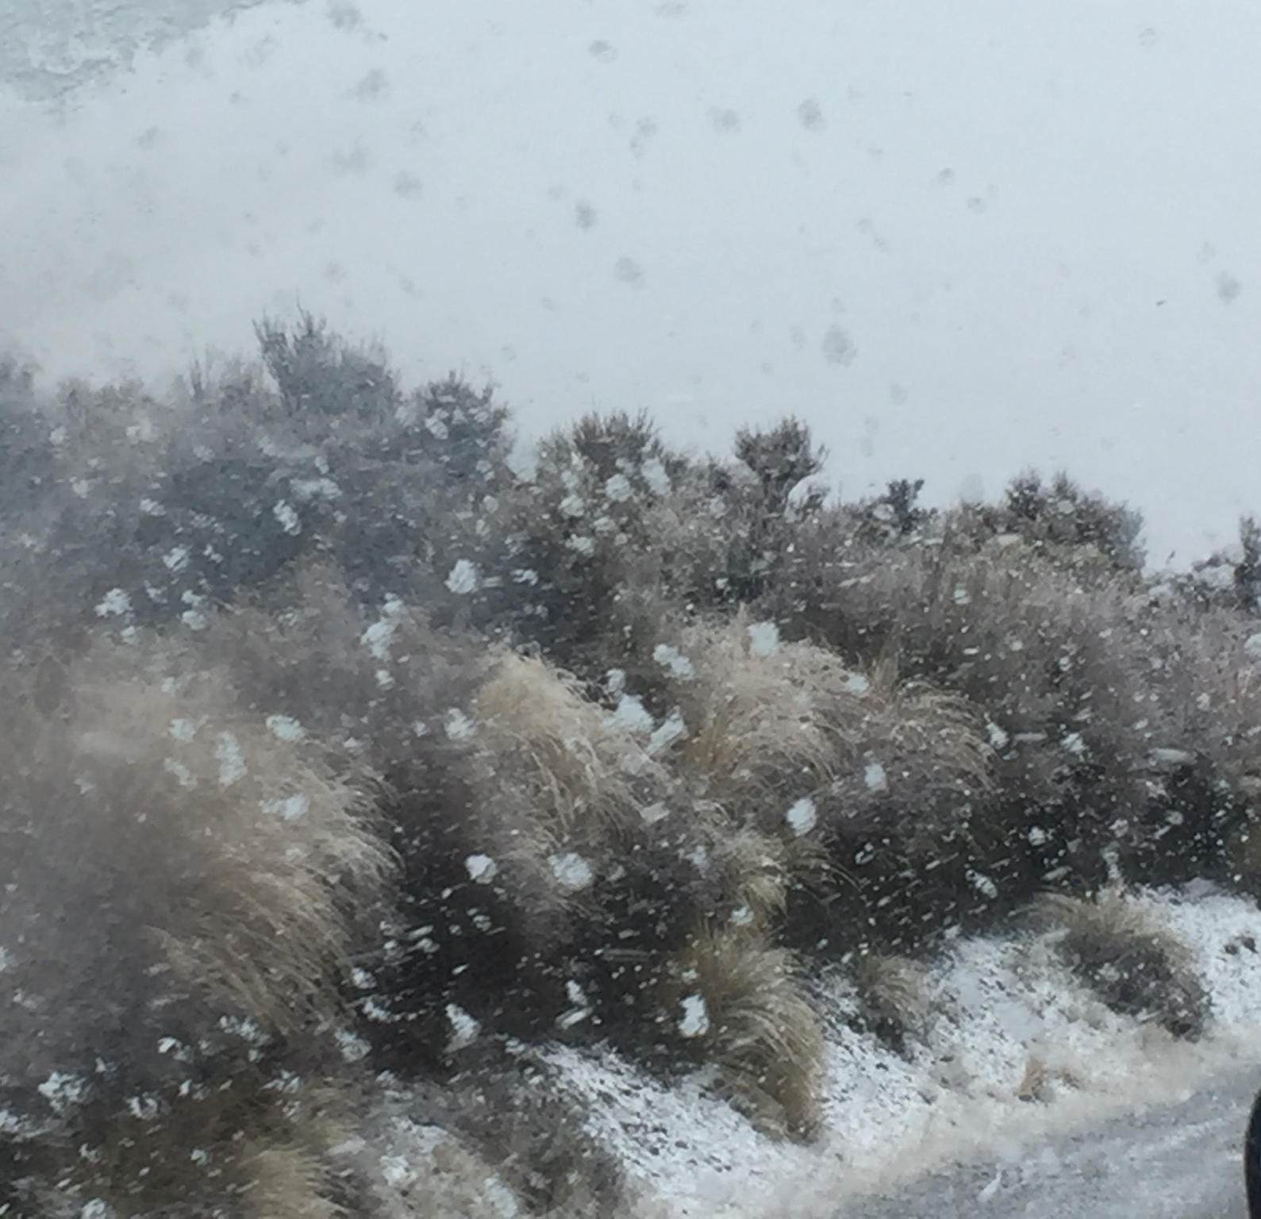
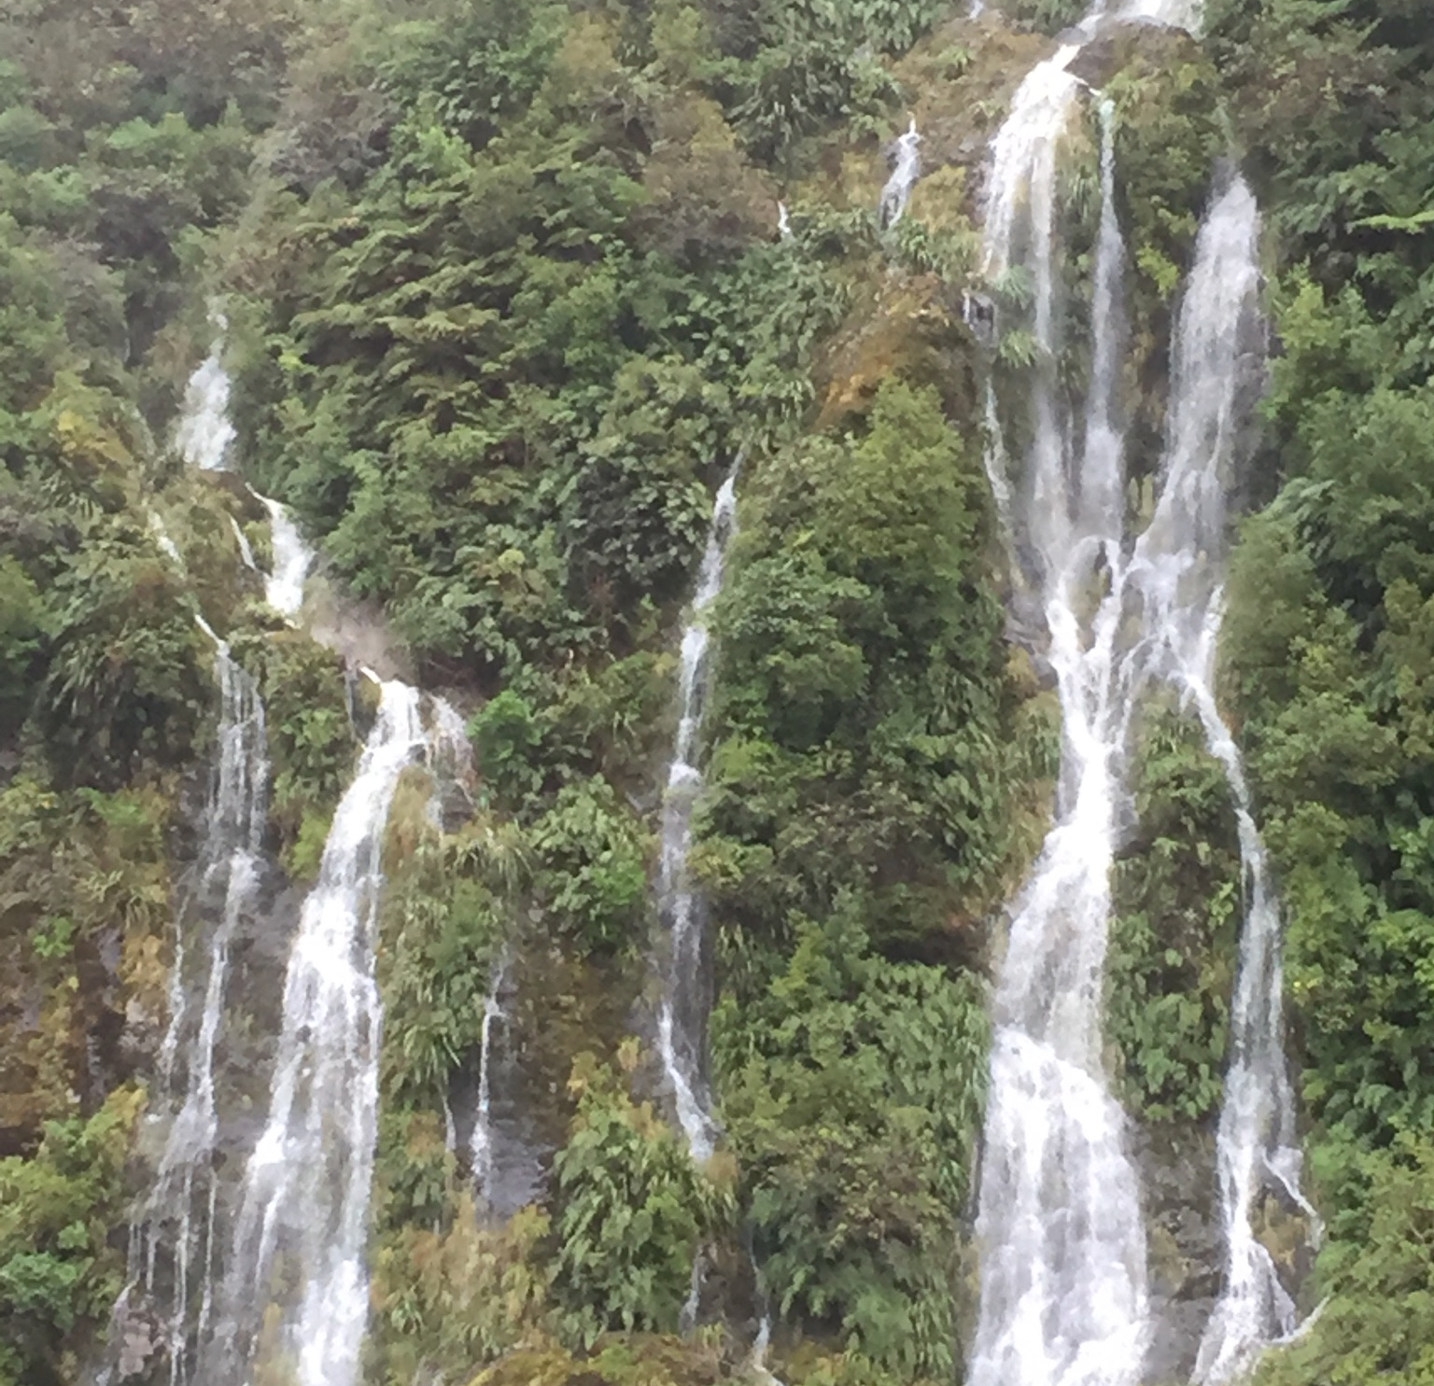
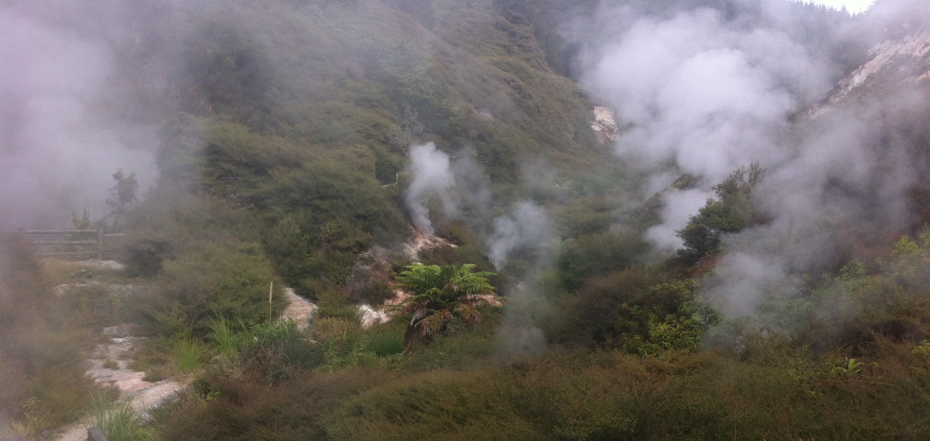
Water can change state – from liquid to solid to gas and back again!
Which states of water can you see in these images?
Notes:
Discussion point:
Water can be a solid (ice, hail) a liquid or a gas (water vapour or steam).
Images:
Left and middle: Sirri Smith
Right: Shanthi Walker

Slide 8
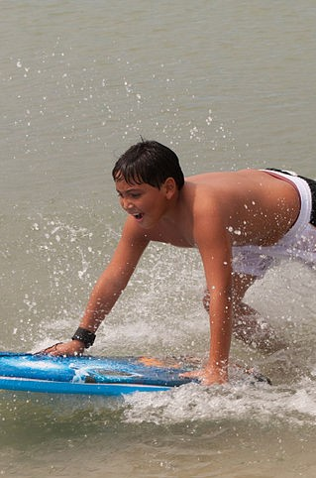
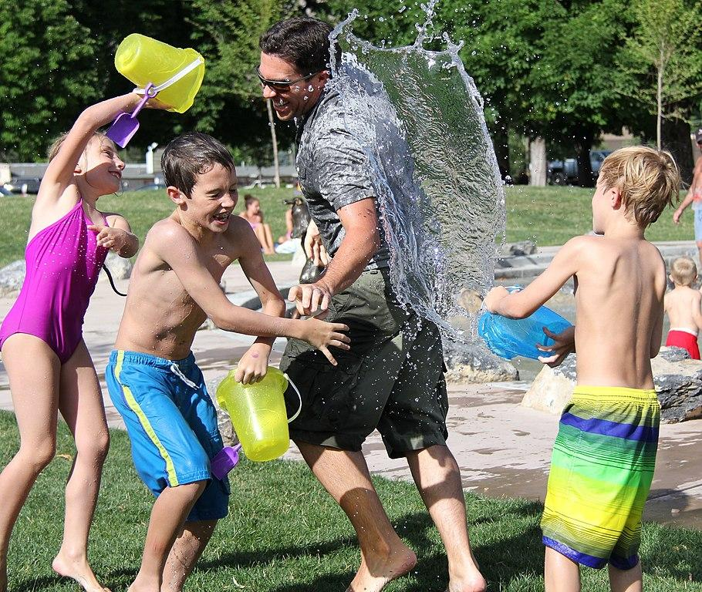
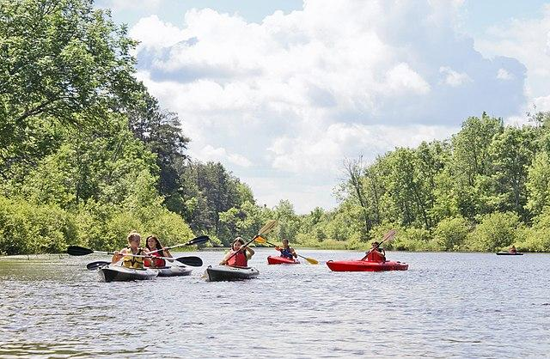
Water is fun!
How do you have fun with water?
Notes:
Images: Public domain

Slide 9
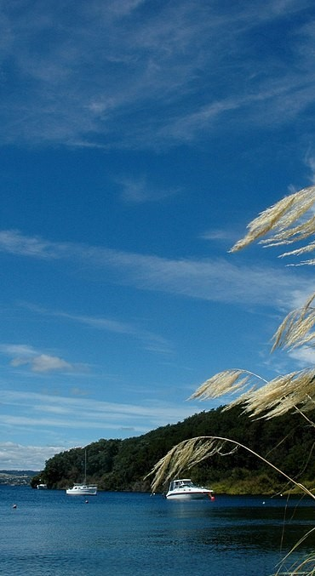
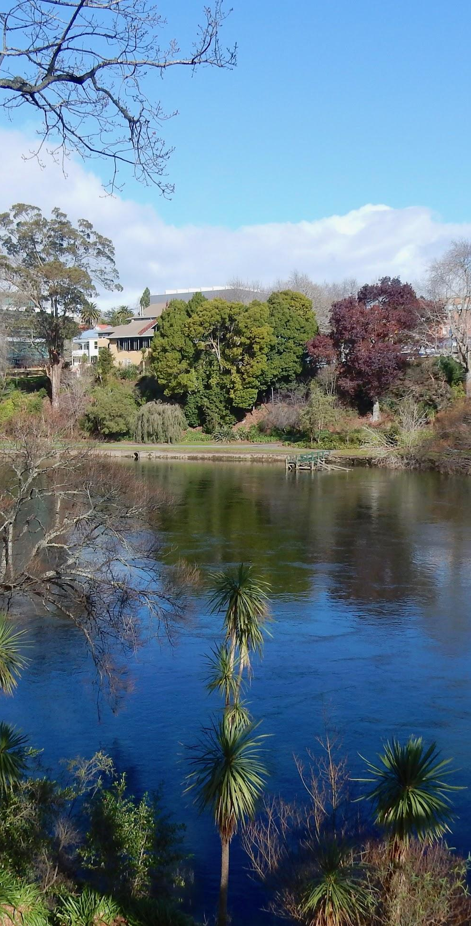
Waikato is well known for its water
Lake Taupō, Waikato River and many more rivers and lakes.
Notes:
Discussion point:
What prior knowledge do students have about Waikato’s water?
Images
Left: Acacia Bay, https://www.flickr.com/people/10807622@N00, CC 2.0
Right: Public domain

Slide 10
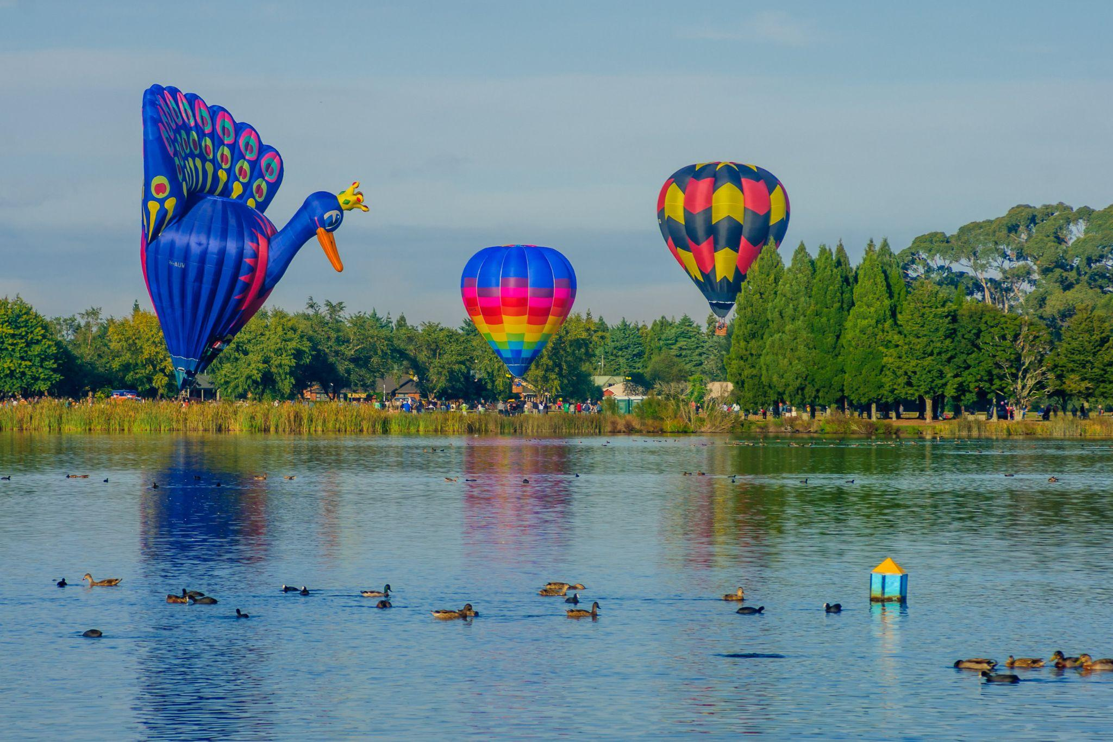
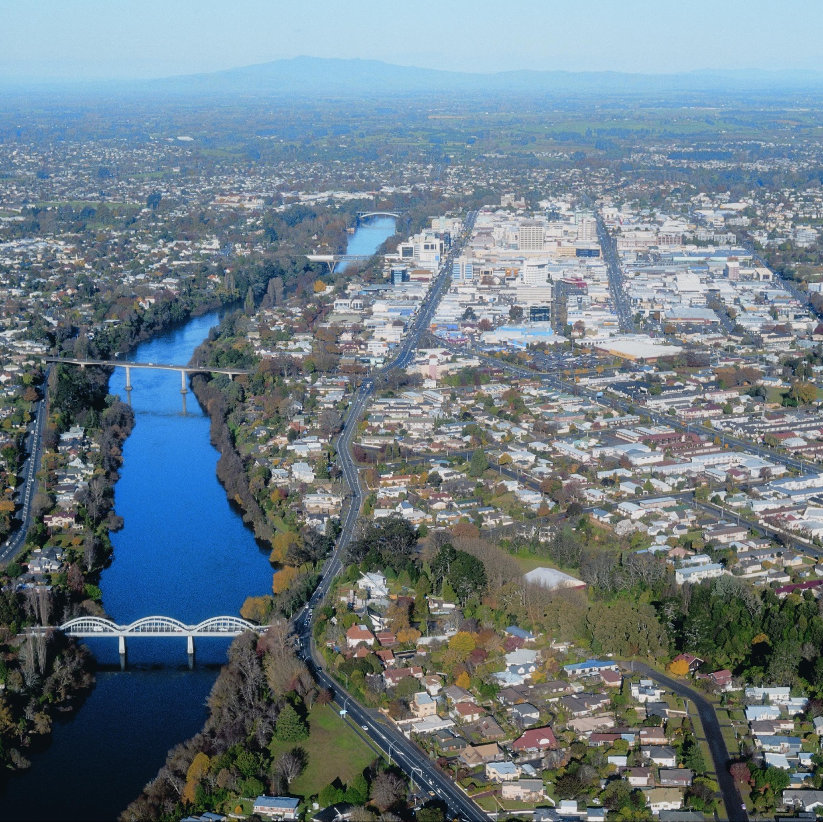
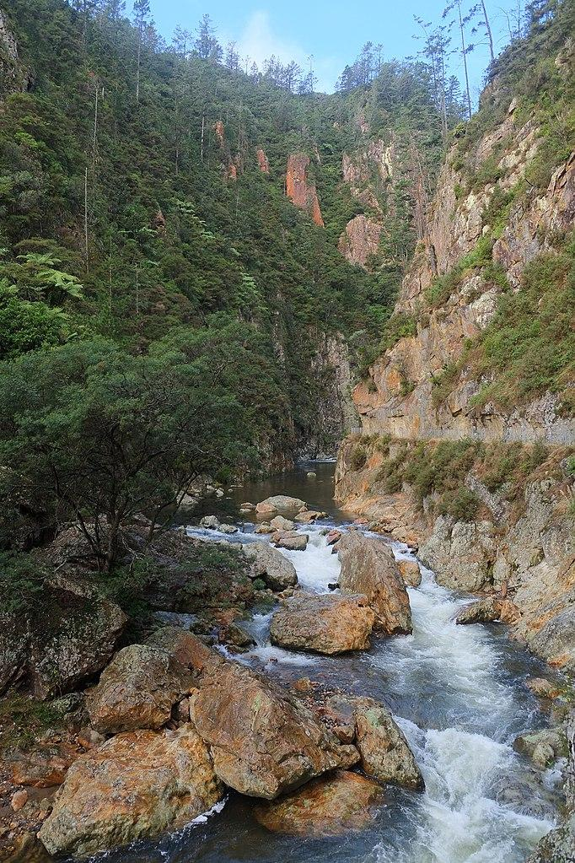
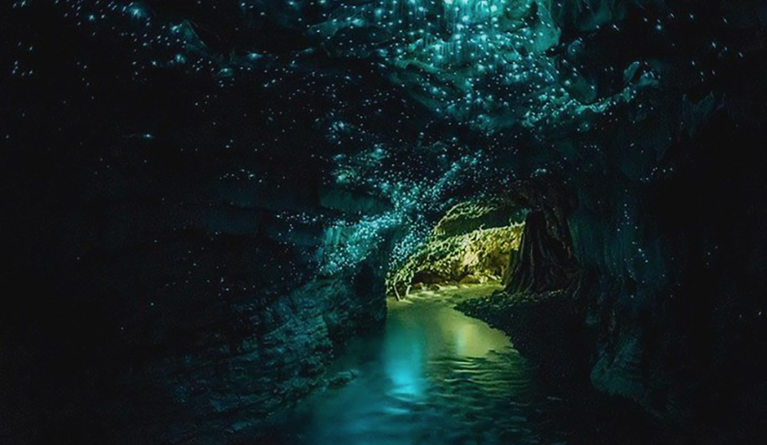
Which waterways do you recognise?
Notes:
Images
Top left: Lake Rotoroa/Hamilton Lake Domain, rndms/123RF.COM
Bottom left: Waitomo Caves, Bethany Cuillo - Flickr
Middle: Waikato River, HCC/S Smith
Right image: Crown Tramway Track in Waitawheta Gorge (Karangahake Gorge area), Public domain

Slide 11
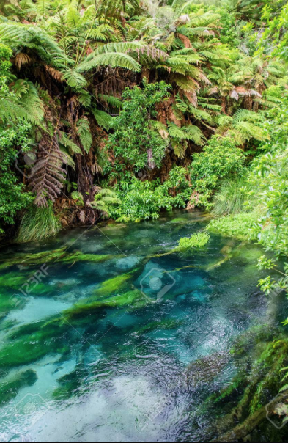
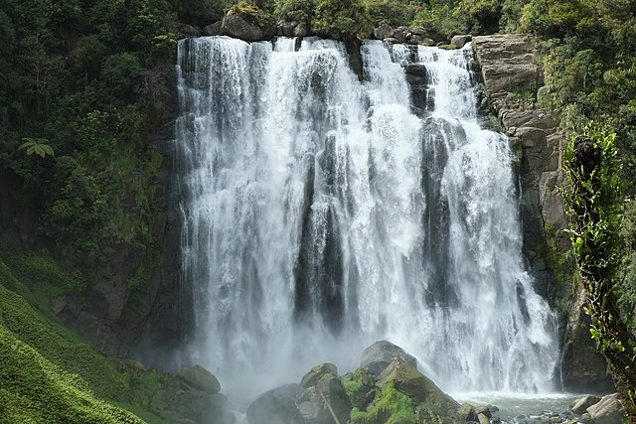
Which waterways do you recognise?
Notes:
Images
Left: Blue Springs, gracethang 123rf
Right: Marokopa Falls, Public domain

Slide 12
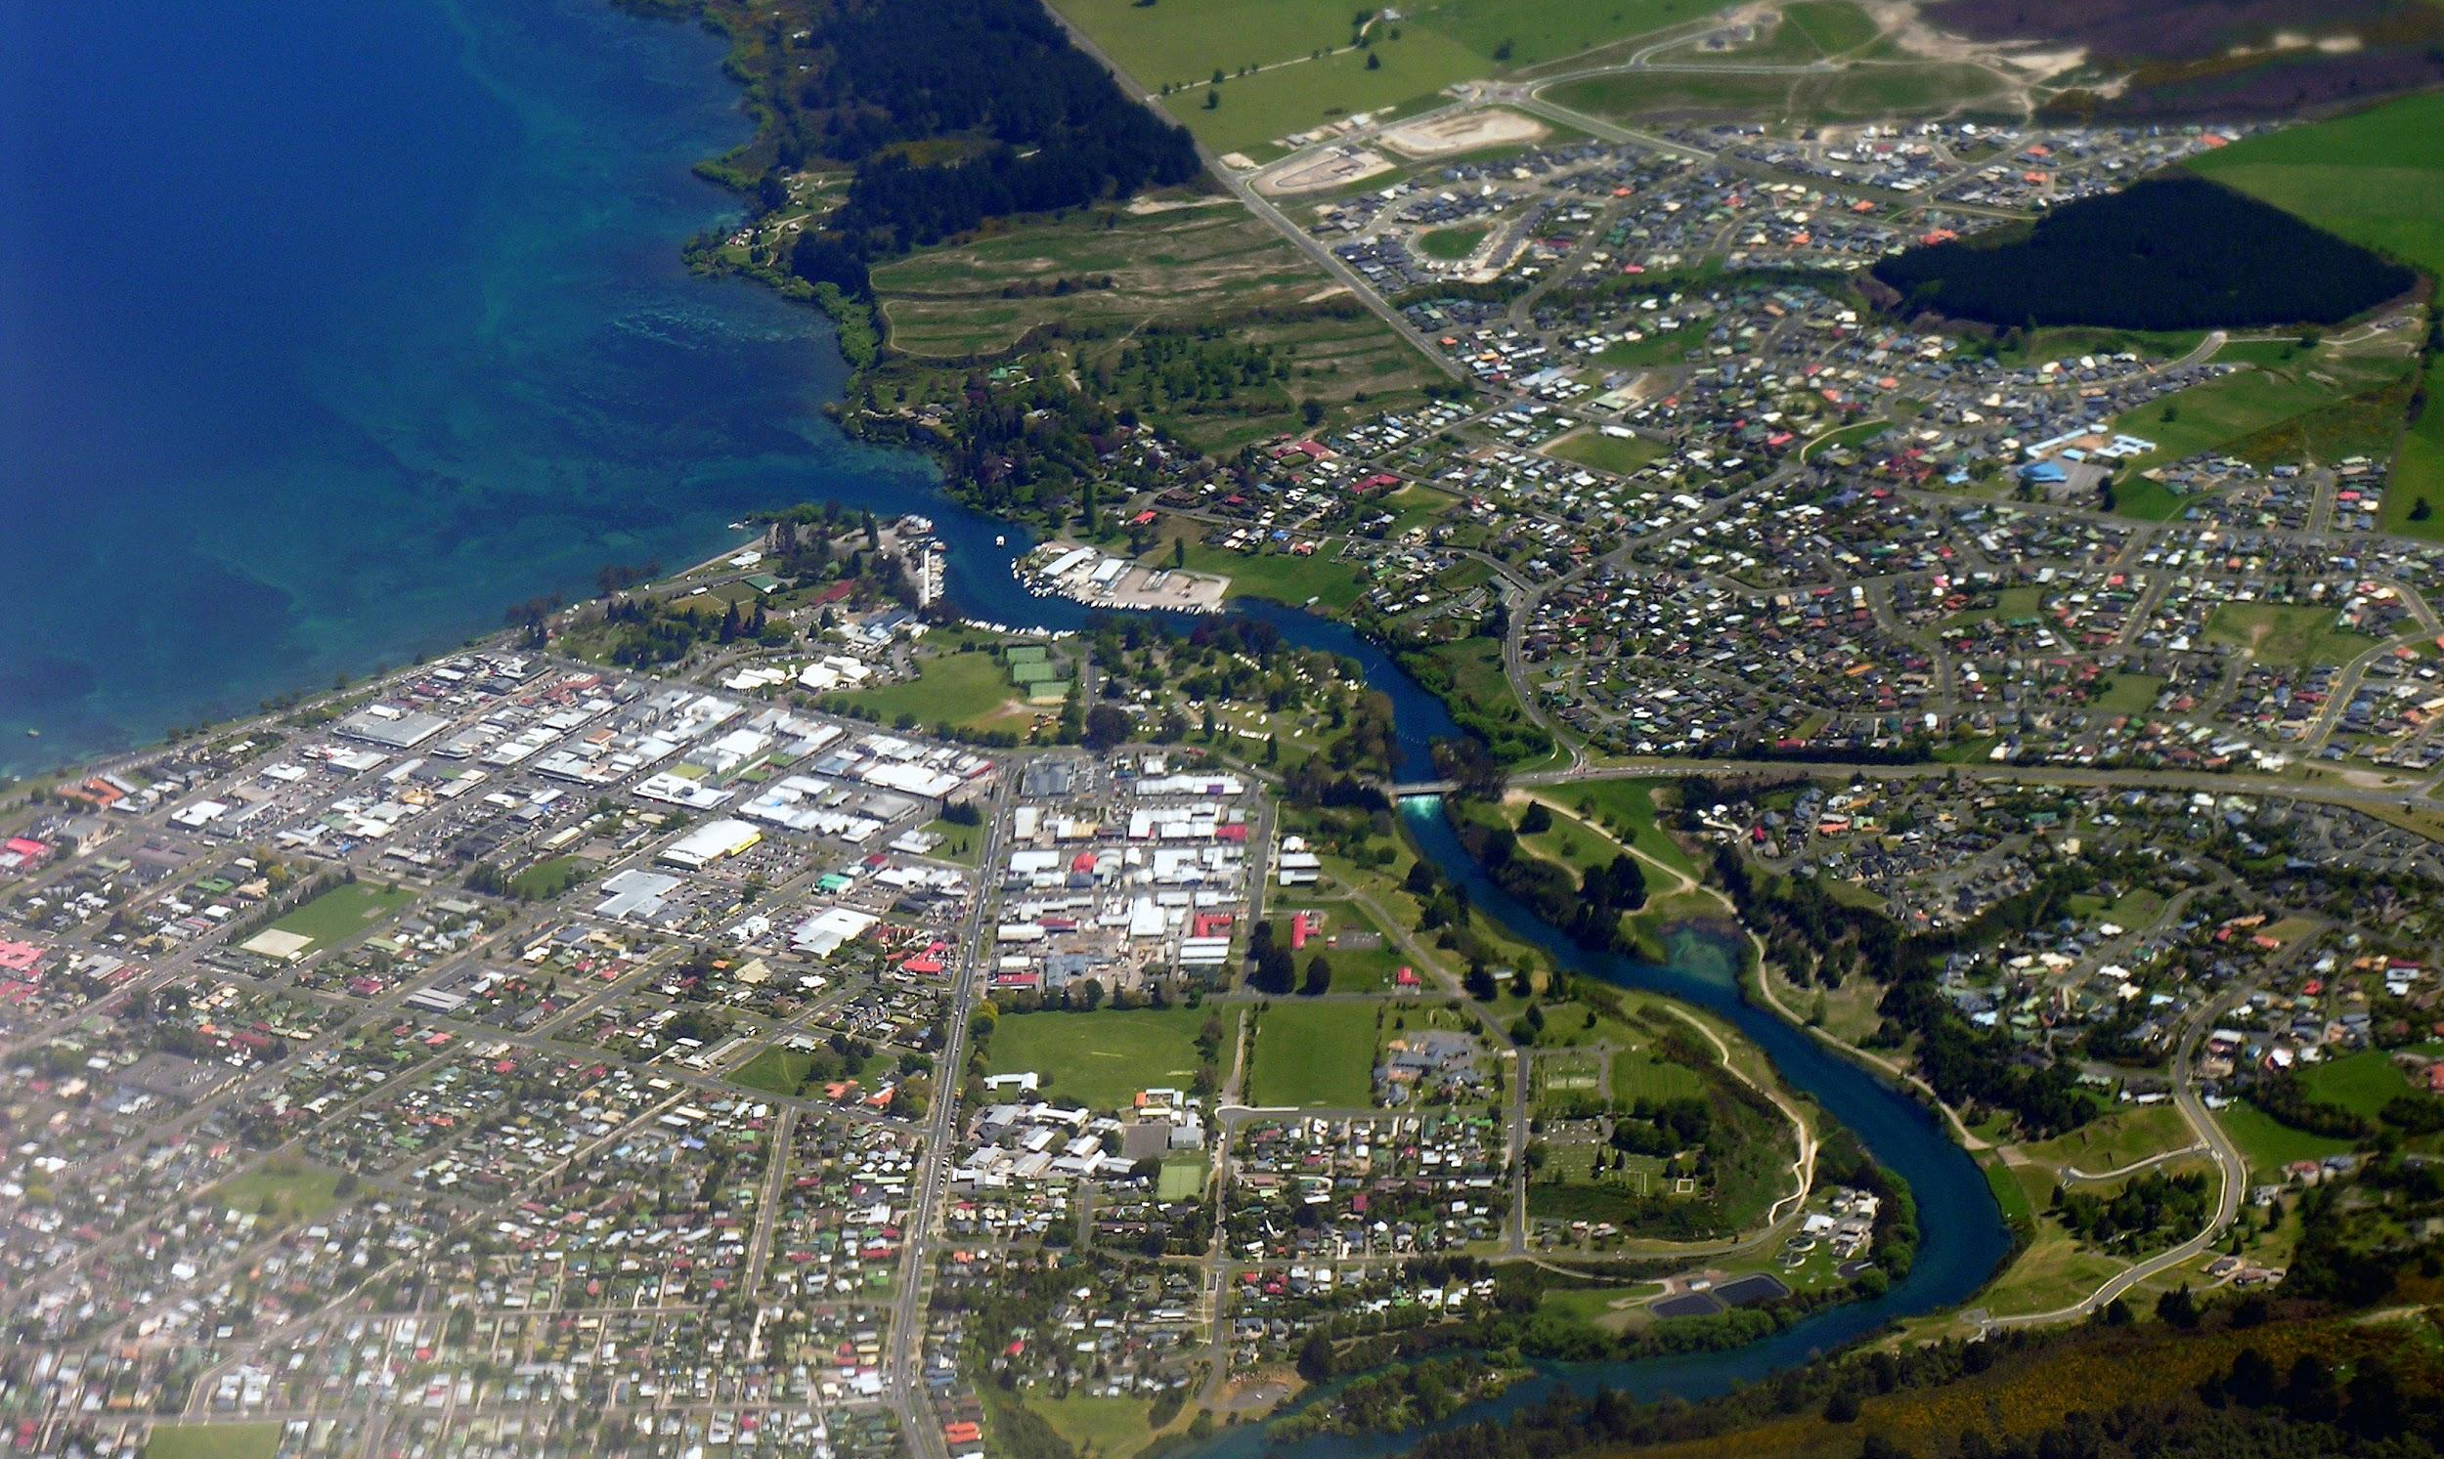
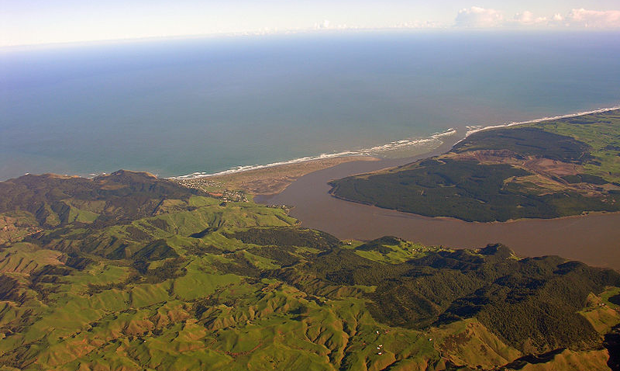
Waikato River – from mountains to sea – ki uta ki tai
Notes:
Discussion points:
What happens to the river water as it makes its way from mountains to sea?
What changes can you see in the water colour and clarity?
Images
Left: Lake Taupō, Phillip Capper, https://commons.wikimedia.org/wiki/File:Lake_Taupo_and_Waikato_River_aerial_view.jpg, CC2.0
Right: Waikato River mouth, Phillip Capper, https://commons.wikimedia.org/wiki/File:Waikato_River_mouth.jpg, CC2.0

Slide 13
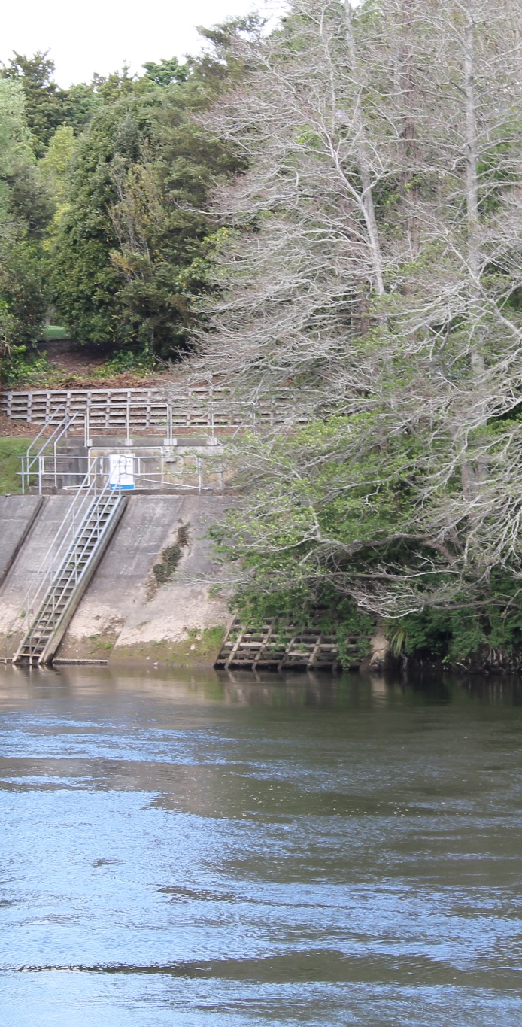
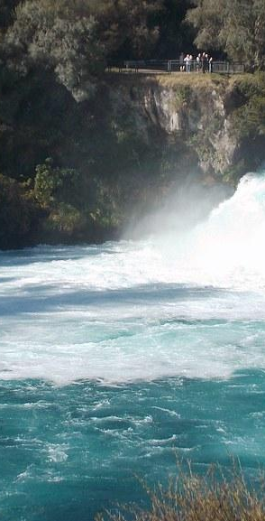
Where does your drinking water come from?
Image by gérard: Flickr
Notes:
Discussion questions:
Where does our tap water come from?
How do we rely on water to survive?
Images
Left: S Smith Waikato Co-op
Right: Gerard, https://www.flickr.com/photos/35803445@N07/34579540686, CC2.0

Slide 14
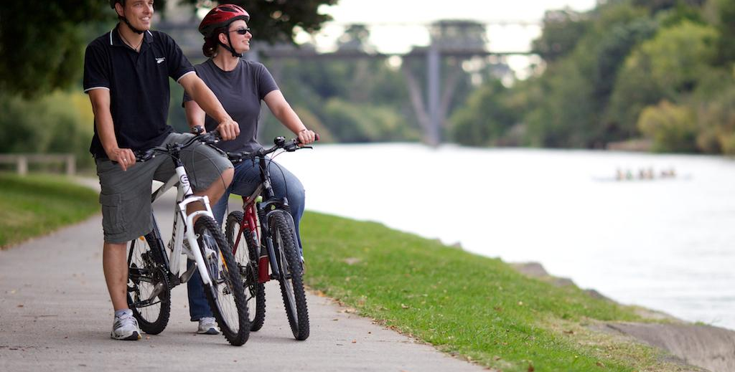
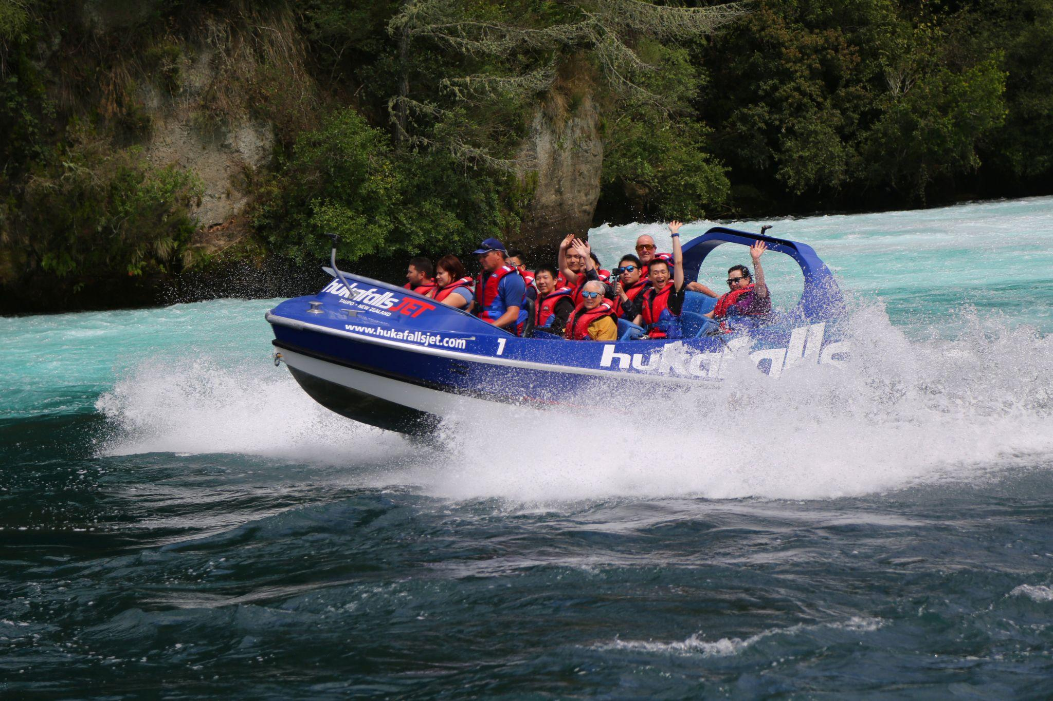
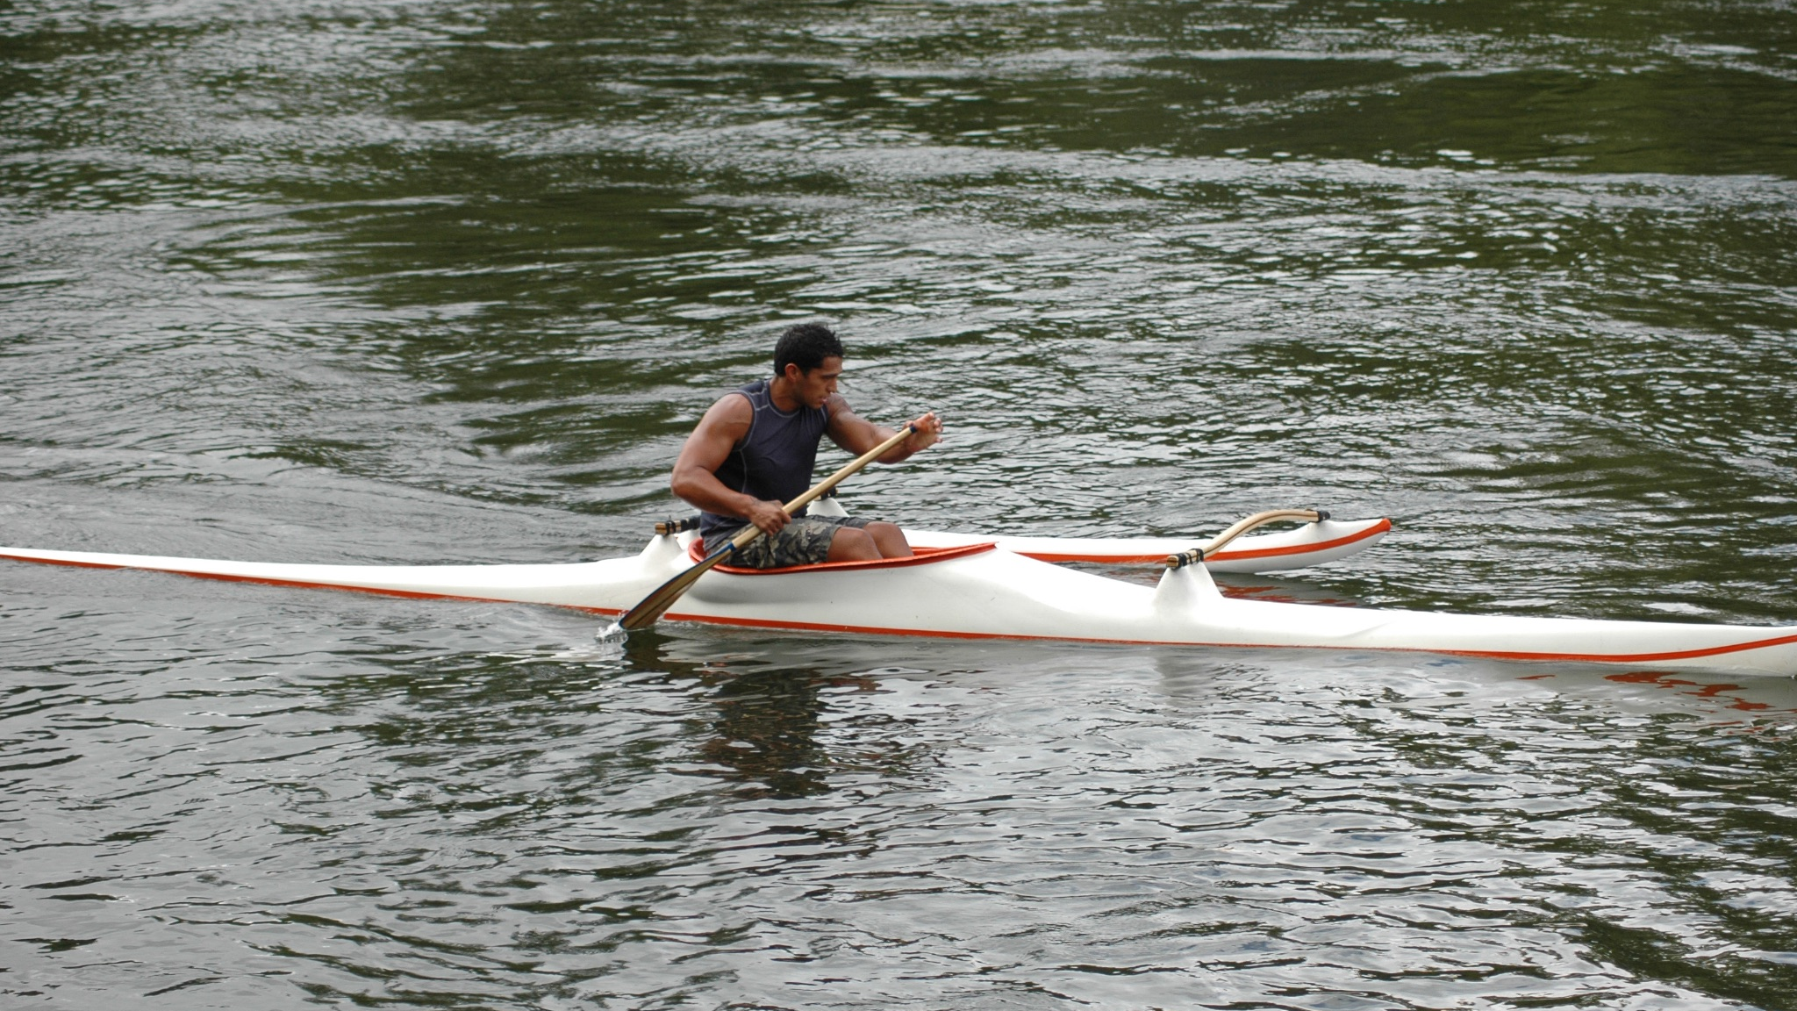
Waterways are awesome places for recreation
Notes:
Images
Left: S Smith, Waikato Co-op
Top right: zhukovsky/123RF.COM
Bottom right: S Smith, Waikato Co-op

Slide 15
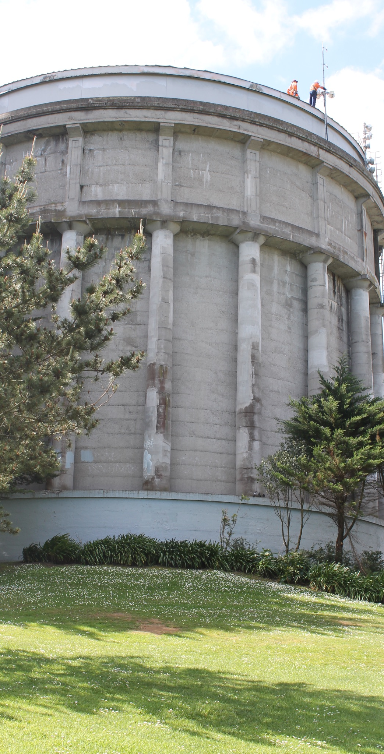
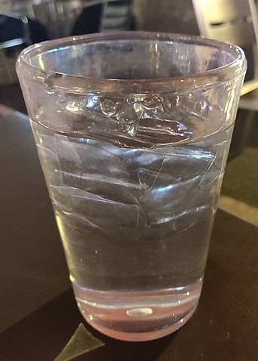
Water treatment
Water requires treatment before it is safe to drink.
We will learn more about the treatment process and how water gets to our taps later in the resource.
Notes:
Images
Left: Hamilton reservoir, Sirri Smith, Waikato Co-op
Right: Public domain

Slide 16
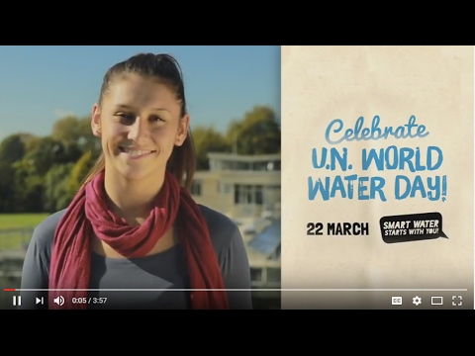
Watch: Smart Water starts with you
Notes:
Click on the title or the image to access the Smart Water video.
Video: © Smart Water

Slide 17

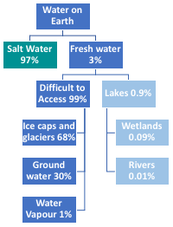
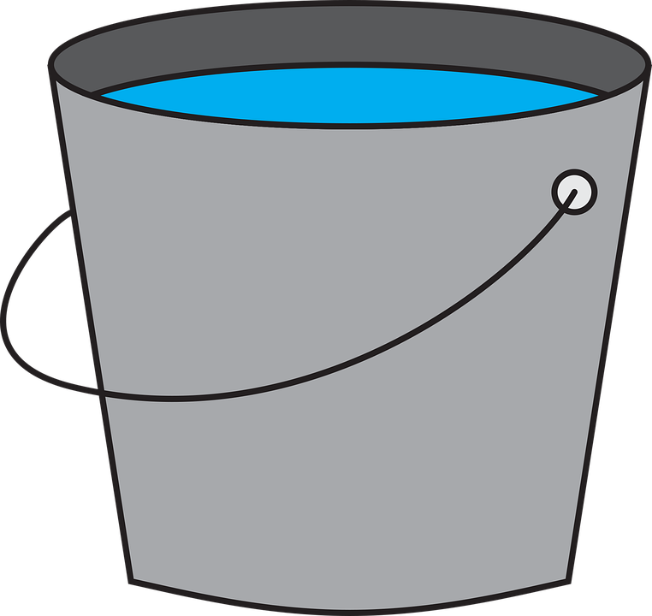
Water on Earth demonstration
Step 1
Step 2
Step 3
You’ll need: a bucket, cup, teaspoon and some water.
Fill a bucket with water.
This represents all the water in the world.
Take a cup of water from the bucket.
This represents all the FRESHWATER on Earth. The rest is saltwater.
Take one teaspoonful of water from the cup. This represents the freshwater that is easy to access on Earth, such as rivers, lakes springs and streams.
Some of this water is ice in glaciers, ice sheets and ice caps and hard to reach.
Water is a precious taonga!
Notes:
Images
Bucket of water: Pixaby https://pixabay.com/vectors/bucket-water-cleaning-clean-pail-5912118/
Earth: Pixaby, https://pixabay.com/vectors/cartography-chromatic-continents-2029310/

Slide 18
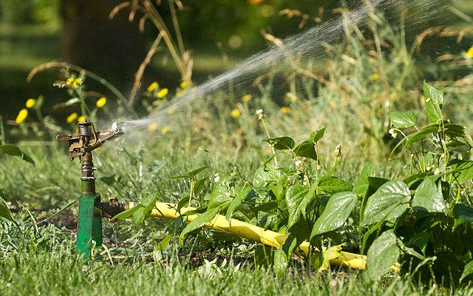
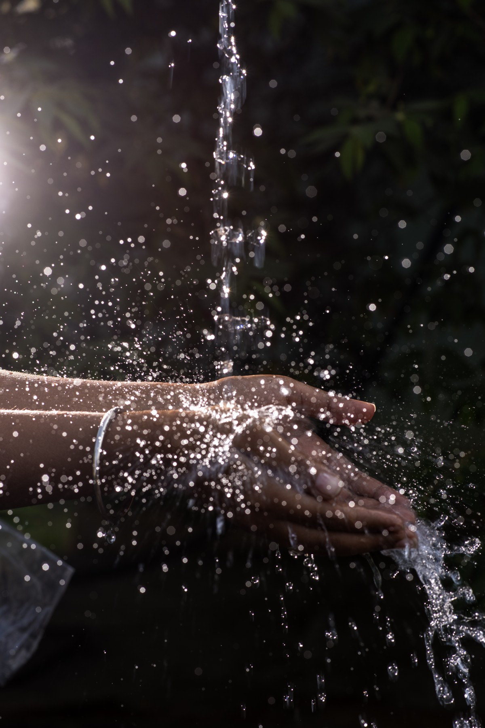
How we use and deal with water matters. Let’s be smart with our water use.
Notes:
Images
Left: PierreSelim, CC 3.0
Right: Public domain

Slide 19

Watch: Smart Water – Water is life
Notes:
Click on the title or the image to access the Smart Water – Water is life video.
Video: © Smart Water

Slide 20
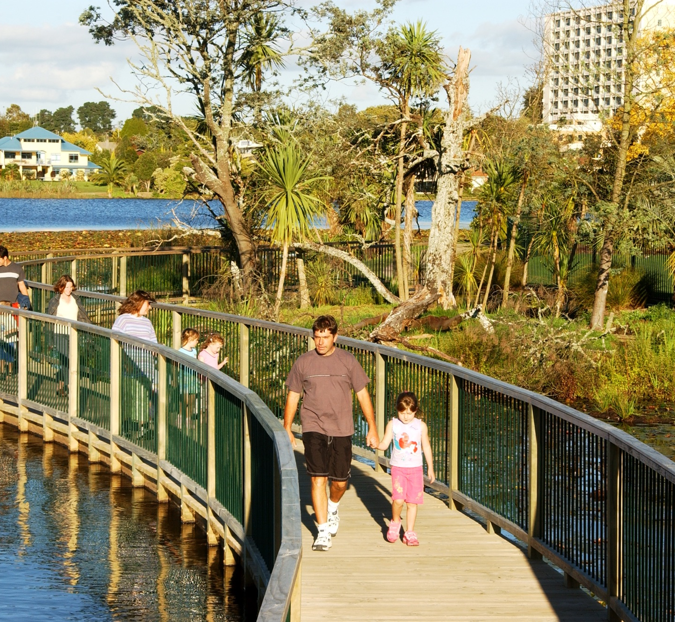
Reflecting on learning
What do you know now about Waikato’s water?
What do you want to know next?
Complete the student handout: Recording our ideas about freshwater.
Notes:
Image
S Smith / Waikato Co-op

Slide 21

Thanks for viewing this slideshow
This slideshow used the aqua theme from Slidesgo
Visit Smart Water for additional education resources and information

